Slide 1
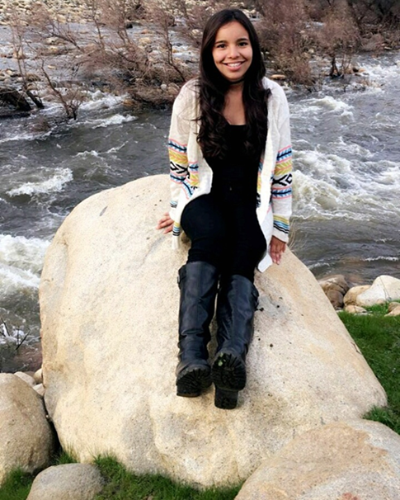
Belen Lemus
Class of 2017

Slide 2
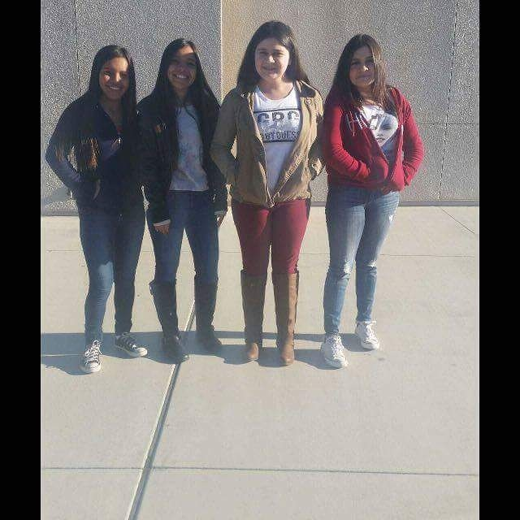
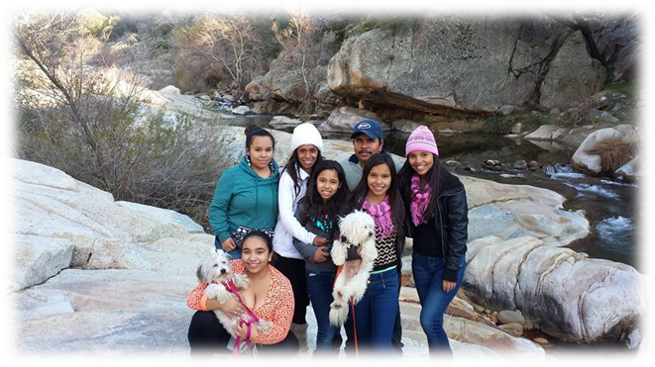
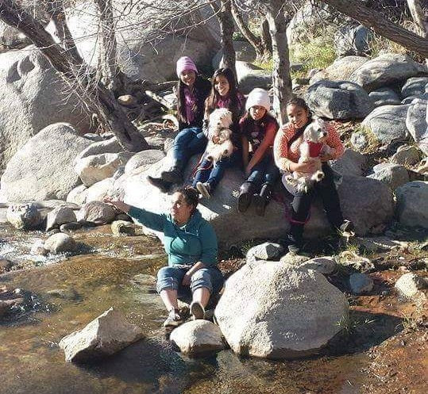
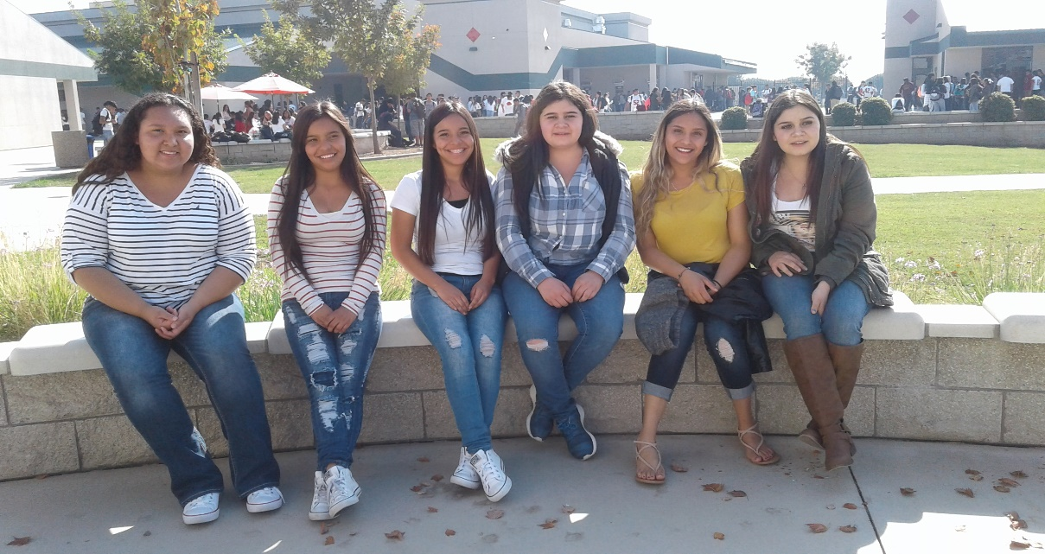
About Me
About Me
I was born here in Lindsay, California.
I am a twin
Two loving parents
4 sisters
Always wished for a brother
Love to
Cook
Babysit
Go on adventures with my family
Hard time growing up
Twin sister had 5 open heart surgeries
Doctors didn't give her hope
Parents were always away
Made it through that big challenge
Cant imagine my life without my twin sister

Slide 3
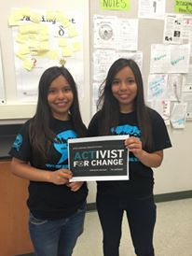
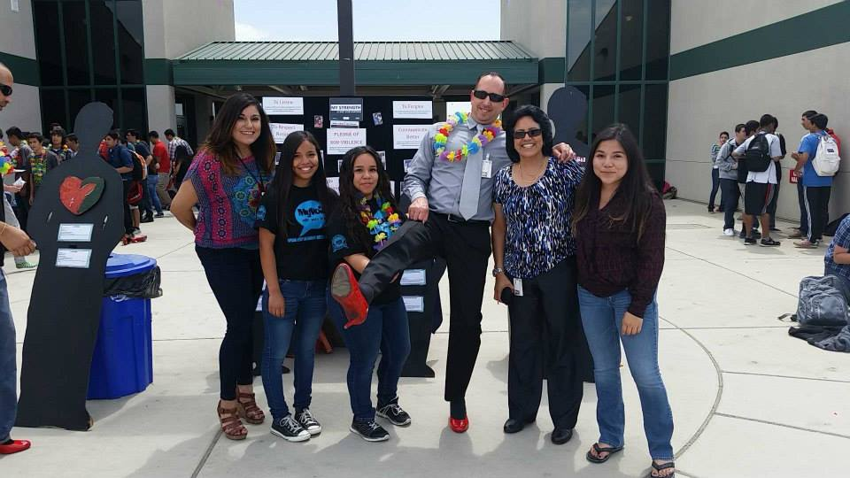
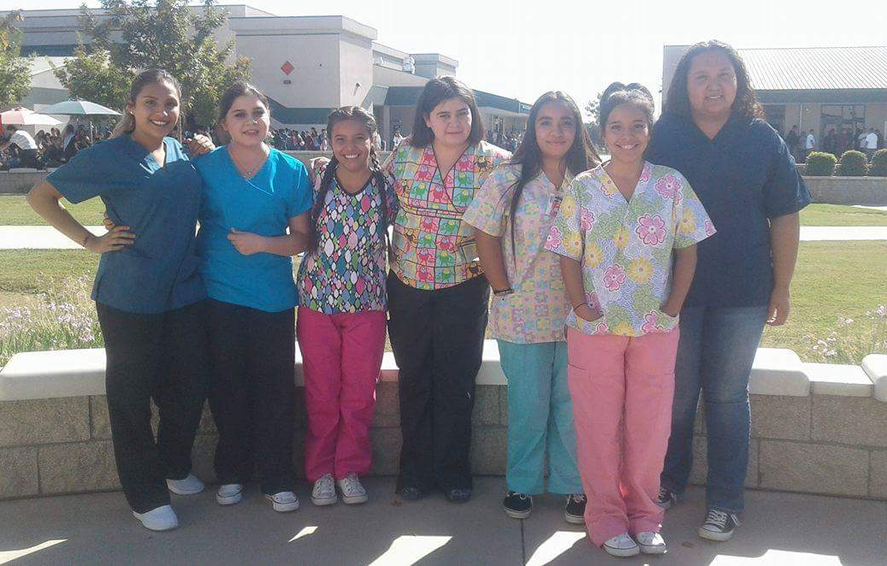
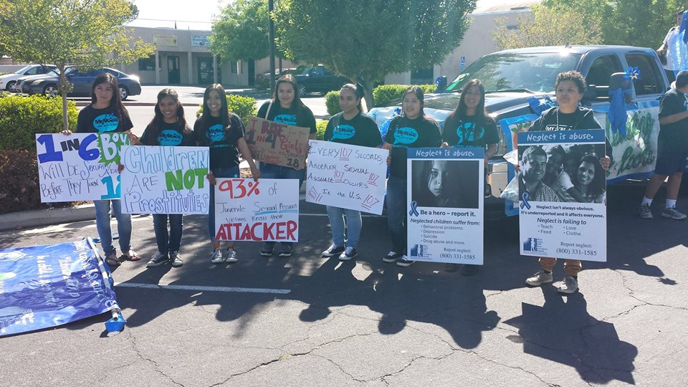
High School Experience
Activities:
President of My Voice Club
Member for 3 years
Allowed me participate in many events
Help the community
Enrolled in CNA course
Main role is to provide basic care to residents in Nursing homes
Became CPR Certified
Currently in clinical at Lindsay Gardens
Hands on experience
Things I learned in HS:
How to be organized
Responsible
Be independent

Slide 4
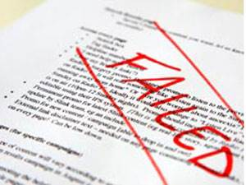
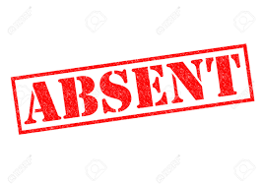
Struggles
Staying on Pace
7 out of 7 seemed impossible
Math
Difficult to understand
Summer School
Passed
Shyness
Hard to ask for help
Ruined many opportunities for me
I am improving

Slide 5
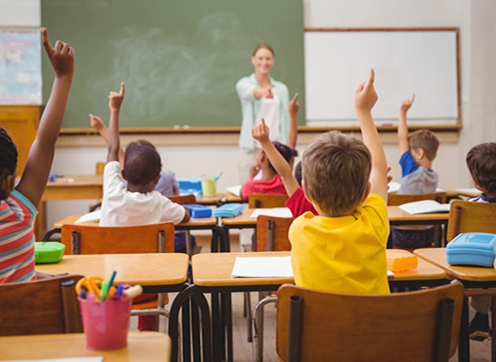
Pathway
Education
Careers in Education Class–2 years
Learned steps to become a teacher
Practice CBEST
Test that allows you to obtain teaching credential
Tutor at Washington Elementary
2ND Year
Interact with kids
Psychology 3rd course
Understand individual learning styles
When I'm a teacher I will understand how every student learns and make learning more effective for them.
Study the social, emotional and cognitive processes
Understand why students act the way they do and how to deal with it

Slide 6
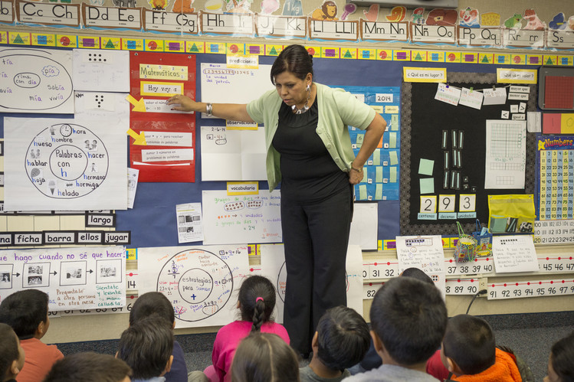
Job Shadow
I chose a second grade teacher because:
Education is my pathway
Interested in Education Career
Love working with kids
That day I got to:
Experience the life of a teacher
Work with students
Helped struggling students complete their class work
Gain Experience
Its something that I am going to do in the future
I loved it!
I am sure that I want to become an elementary teacher
I will do everything I can to accomplish my dream.
Grace Hernandez – 2nd Grade Teacher at Jefferson Elementary School
She was my 1st Grade teacher
I wanted to be like her when I was little
Start to accomplish that dream

Slide 7
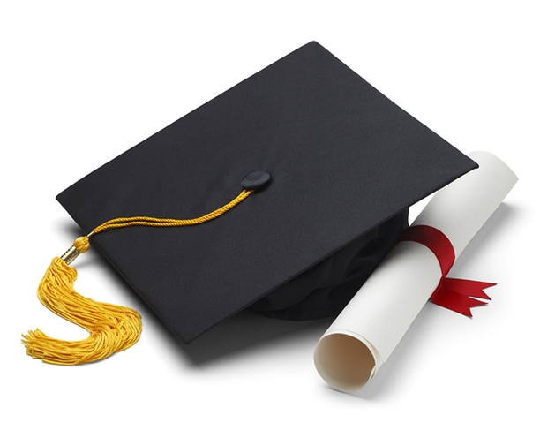
Post High School Plans
College of the Sequoias -2 years
Major in Liberal studies
Obtain Associates Degree
Transfer to University -Fresno State or Bakersfield
Obtain Bachelors and Masters degree
Credentialing Program –Obtain teaching credentials
I will have Financial support from my parents and possibly FAFSA.

Slide 8
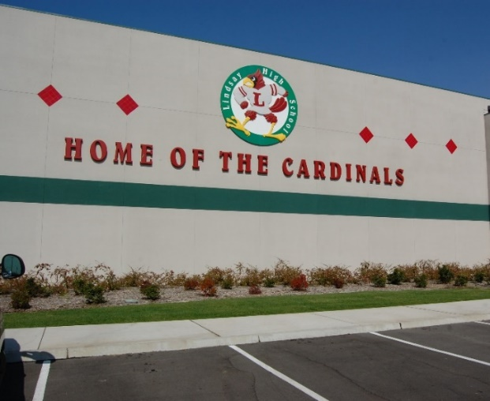
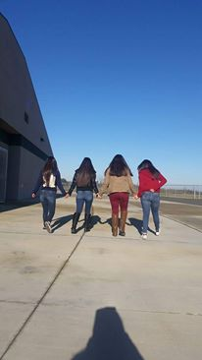
Leaving LHS ☹
Thankful for all my teachers that helped me get through these four years.
Always encouraged me to do my best
PBS system taught me that even though I am working at my own pace I still need to turn everything in on time
Helped prepare me for college.
Made me responsible
Taught me to be organized
I will always remember high school because of all the great memories, staff and friends.

Slide 9
Any Questions?
Thank you so much for your time!

